Slide 1

Basic Details of the Team and Problem Statement
Ministry: Ministry of Electronics and Information Technology
PS Code:PK860
Problem Statement Title: Sustainable and No contact Attendance System
Team Name: The Achievers
Team Leader Name: Mohammed Mudassir
Institute Code (AISHE): C-1395
Institute Name: HKBK College of Engineering
Theme Name: Smart Touchless and Paperless Attendance System

Slide 2
Idea/Approach Details
Biometric attendance induced a sense of fear as well as psychological unease during the corona pandemic since it spread very fast .
In this project, we propose a Smart Touchless and Paperless Attendance System based on Facial Recognition, Posture detection and Mobile app verification, thereby securing the way of taking attendance without causing any psychological unease and to avoid spread of viruses. By employing these techniques, we are able to overcome the drawbacks of the existing smart Attendance system which includes higher rate of error percentage, spread of infectious diseases through contact, difficulty and error in scanning.

Slide 3
Describe your Technology stack here:
Hardware – Raspberry Pi Module, Bluetooth module, Camera
Programming languages – Python, Java
API –OpenCV, AndroidStudio, Bluetooth Library
Database – Firebase Library

Slide 4
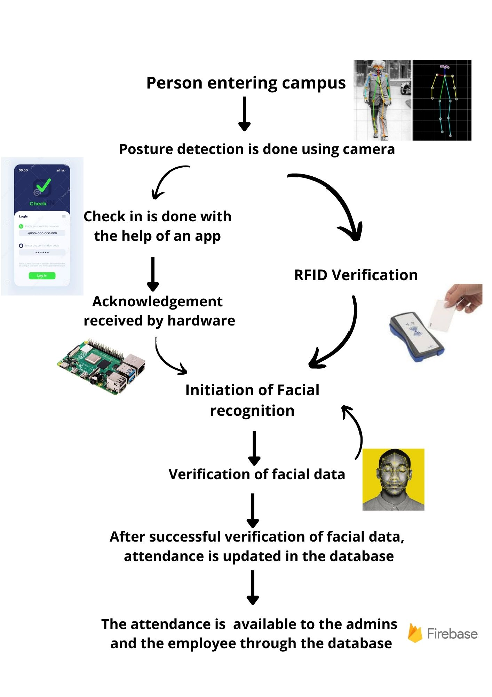
Flowchart of the proposed work :

Slide 5
Idea/Approach Details
Describe your Use Cases here
Describe your Dependencies / Show stopper here
In Schools and Colleges we can use this amazing technology for taking the attendance of both Students and staff and the attendance can be sorted according to week or month.
In factories we can you this for taking attendance of workers/laborers. Their it would be more useful as some people won't be knowing to read an derived and hence making it far more easier to track them or take their attendance.
In Offices we can use this for tracking the attendance of the employees In Hospitals this is very useful as normally.
in hospitals their is a chance of infection/contamination so we can use this to take the attendance of Doctors and Nurses without touching anything.
Light intensity
as the attendance is taken in the morning and evening time the camera can easily recognize both posture and face but if it has to be taken during night times then we can use a separate light source in those cases
Power cut
If incase the power cut has occurred then noting down attendance would be an issue which can be rectified by connecting the system to the backup power supply like ups.

Slide 6
Team Member Details
Team Leader Name: Mohammed Mudassir
Branch (Btech/Mtech/PhD etc): Btech Stream (ECE, CSE etc): ECE Year (I,II,III,IV): II
Team Member 1 Name: Nevin Santhosh
Branch (Btech/Mtech/PhD etc): Btech Stream (ECE, CSE etc): ECE Year (I,II,III,IV): II
Team Member 2 Name: Ramesh G
Branch (Btech/Mtech/PhD etc): Btech Stream (ECE, CSE etc): ECE Year (I,II,III,IV): II
Team Member 3 Name: Mohammed Shakir Sayeed
Branch (Btech/Mtech/PhD etc): Btech Stream (ECE, CSE etc): ECE Year (I,II,III,IV): II
Team Member 4 Name: Manfusa Aiman
Branch (Btech/Mtech/PhD etc): Btech Stream (ECE, CSE etc): ECE Year (I,II,III,IV): II
Team Member 5 Name: Krishan Kumar Bhushan
Branch (Btech/Mtech/PhD etc): Btech Stream (ECE, CSE etc): ISE Year (I,II,III,IV): III
Team Mentor 1 Name: Dr. Sanjana Prasad
Category (Academic/Industry):Academic Expertise : AI,ML,Embaded-system Domain Experience (in years): 6

